Slide 1
Factor Based Investment in Indian Equities
Group#8
Jithesh / Vinod Kumar /Tarique / Shivkumar
Research Supervisor
Pranov Mishra

Slide 2

Agenda
Project Summary
Dataset Structure
Exploratory Data Analysis
Project Approach
Model Summary
Findings and Recommendation

Slide 3
Project Summary
Assessing the Impact of Variables on the Current Year’s Adjusted EPS
Gathering data on primarily financial ratios related to Nifty 500 Companies
Organize the data based on Macro-Sectors: Consumer, Banks and Financial Services, Commodities and Manufacturing
Categorizing firms as Growth and Non-Growth firms based on the Annual Adjusted Earnings per Share
All Firms above the median Adjusted Earnings Per Share have been considered as Growth (1) and the ones below have been considered as Non-Growth (0)
Lagging the dataset by 1 Year, for example, the Growth Category of 2019 becomes the Y-Variable to predict for the Year 2018
Leveraging Tableau and R to carry out exploratory data analysis
Logistic Regression and Tree-Based Models such as Random Forest and RPART has been applied to predict the category to which the firm belongs to i.e. Growth or Non-Growth
Linear Regression has been applied to predict the impact of significant financial ratios on the Earnings Per Share
The dataset is transposed with Company names as rows and columns having the significant variables from the previous step
The Significant variables derived from the Logistic Regression and Tree-Based models are then converted to Slope and Average. 2018 Value of sig. variables are also considered
Logistic Regression model is applied on the Slope, Average and 2018 Variable Value to predict the growth category in 2019
Applying Statistical Techniques and Tools such as Logistical Regression, Tree Models and Linear Regression

Slide 4
DATA STRUCTURE
10 Years Data (2009 – 2019)
Nifty 500
3672 Rows, 67 Columns
336 Firms
Macro-Sectors
Banking and Financial Services
Consumer
Commodities
Manufacturing
BANKS
FINANCIAL SERVICES
AUTO
CONSUMER DURABLES /NON- DURABLES
MEDIA & ENTERTAINMENT
RETAILING
TEXTILE
CEMENT
CHEMICALS
FERROUS /NON-FERROUS METALS
FERTILISERS
MINERALS/MINING
PAPER
PESTICIDES
AUTO ANCILLARIES
CONSTRUCTION
INDUSTRIAL

Slide 5
VARIABLE LIST
Financial Ratios / Percentages
VR_Adjusted_PE_ VR_P_CE VR_P_BV VR_Dividend_Yield VR_Mcap_Sales VR_High_PE VR_Low_PE FR_Price_CF_Ratio FR_Price_to_FCF FR_FCF_Yield FR_Sales_to_CF_ratios FR_Tax_Rate_P FR_Dividend_Pay_Out_Ratio_P FR_PBIDTM_P FR_EBITM_P FR_Pre_Tax_Margin_P FR_PATM_P FR_CPM_P FR_Adj_EPS_Growth_P | FR_ROA_P FR_ROE_P FR_ROCE_P FR_Asset_Turnover FR_Inventory_Turnover FR_Debtors_Turnover FR_Fixed_Asset_Turnover FR_Sales_Working_Capital FR_Net_Sales_Growth_P FR_Core_EBITDA_Growth_P FR_EBIT_Growth_P FR_PAT_Growth_P FR_Total_Debt_Equity FR_Current_Ratio FR_Quick_Ratio FR_Interest_Cover FR_Total_Debt_Mcap NDP_PE NDP_Price_BV
Numeric Values
FH_FCF PL_NetSales PL_PAT FR_FCF_Per_Share FR_CEPS_Rs FR_Adj_DPS_Rs FR_Adjusted_Book_Value_Rs FR_Fixed_Capital_Sales FR_Receivable_days FR_Inventory_Days FR_Payable_days NDP_Volume NDP_Mcap NDP_Close FR_Adj_EPS
Categorical Variables
Company_Name Industry MacroEconomicSector FR_Year_End (Date) Momentum Credit_Rated

Slide 6
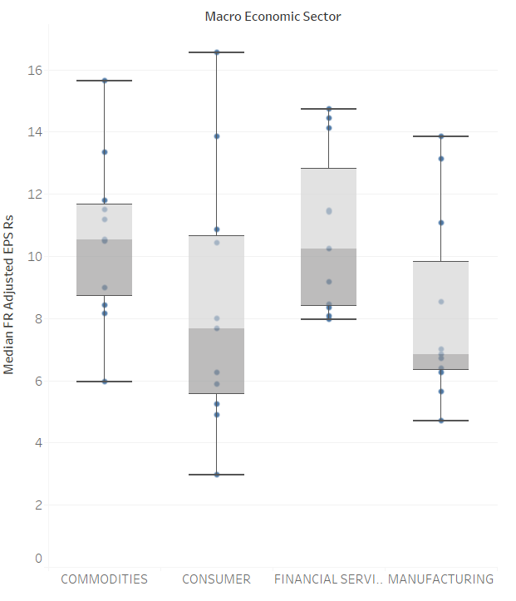
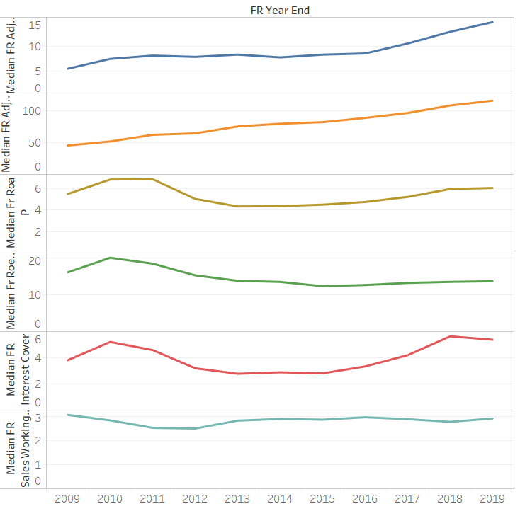
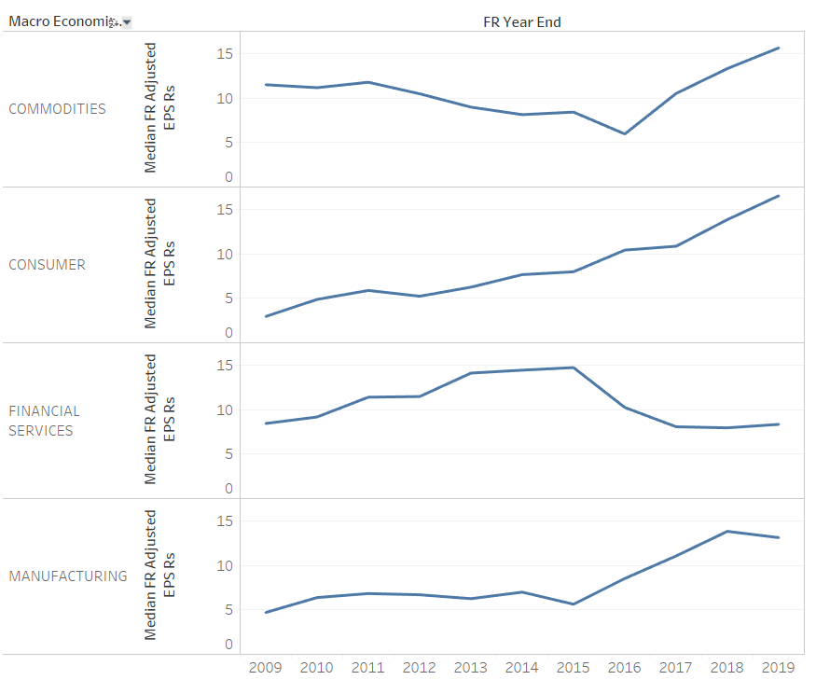
EDA – GENERIC FINDINGS
There are few highly correlated variables in the data which are treated during modelling stages
Variables are largely normally distributed barring some outliers which are considered to be ‘extreme values’
Few variables follow the trend of Adjusted EPS across the time period, shows high correlation(Adjusted Book value, ROA, ROCE, ROE, Dividend payout ratio, Debt to Mcap ratio, Interest Cover, to name a few).
Select firms in every macro-sector outperformed the rest
Shree Cement in Commodities
Bajaj Holdings in Financial sector
EDA

Slide 7
EDA - SECTOR SPECIFIC
Banking and Financial Services
Adjusted EPS across Companies increased in the first two years and has stabilized over the last 8 years
Consumer
Significant growth in Adjusted EPS from 2015
Return on Assets was the highest in 2010
Capital Employed has increased by 3 times since 2009
Commodities
Free Cash Flow lower for Steel Industry
The adjusted EPS had dropped significantly in 2016 for the companies in commodities sector and started to pick up again afterwards.
Ferrous metals industry is showing more variability in terms Adjusted EPS growth more than any.
Manufacturing
A level shift in Adjusted EPS observed in the year 2016, predominantly led by MRF within the auto-ancillaries industry.
Adjusted Book value for auto ancillaries grew consistently throughout the years compared to all other industries.

Slide 8

PROJECT APPROACH
Linear Regression
Ridge/Lasso/Elasticnet
Support Vector Machines
Banks & Financial Services
Normal Dataset
Transposed Dataset
Consumer
Logistic Regression
Random Forest
RPART
X
X
Nifty 500
Slope, 3-Year Average, 2018 Value
Financial Ratios
Lagged Dataset
Y
Commodities
Y
Growth Category of the Firm based on Adjusted EPS
Logistic Regression
Growth Category of the Firm based on Adjusted EPS
Manufacturing

Slide 9
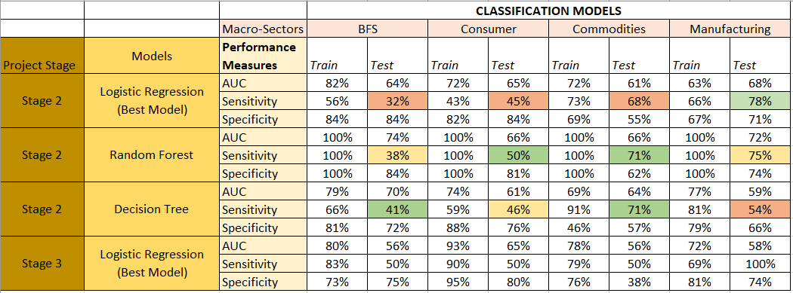
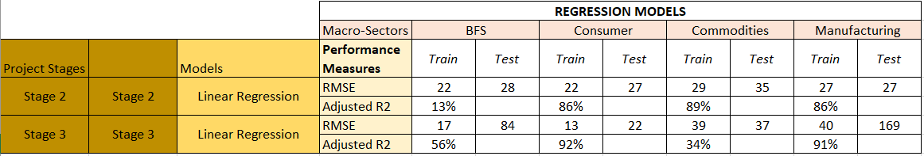
MODEL SUMMARY
CLASSIFICATION
Target Variable – Growth Category
Random Forest is overfitting the Train Data across Macro-Sectors
Decision Trees based on RPART model are giving out better Sensitivities for BFS, Consumer and Commodities
Logistic Regression is giving out better Sensitivities across Commodities and Manufacturing
REGRESSION
Target Variable – Adjusted EPS in RS.
Adjusted R² for Consumer, Commodities, Manufacturing is more than 80

Slide 10
MODEL OUTPUTS
Banking and Financial services
Commodities
Manufacturing
Consumer

Slide 11
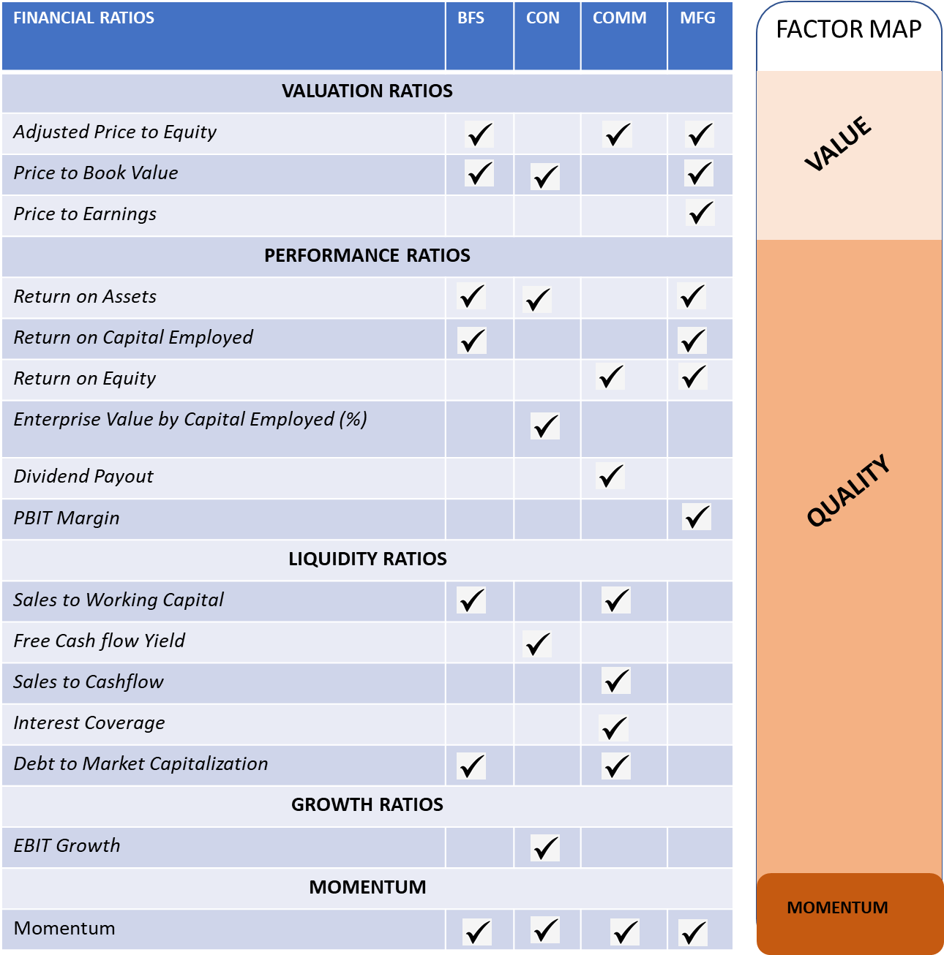
FINDINGS AND RECOMMEDATIONS
Findings linked to Objectives
MOMENTUM is a significant variable impacting the stock performance across macro-sectors
Financial Ratios play a key role in the QUALITY factor to determine the Growth category of a firm
Adjusted Price to Equity, Price to Book Value & Return on Assets are the key driving Financial Ratios
Recommendation
An investor looking to invest in a company from these 4 different macroeconomic sector should consider the health of these sector specific factors before making and investment decision

Slide 12
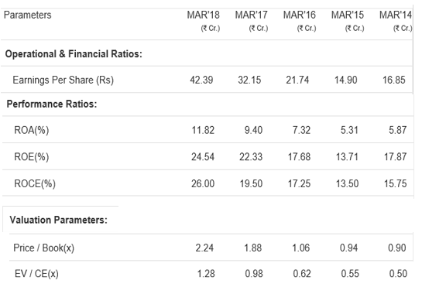
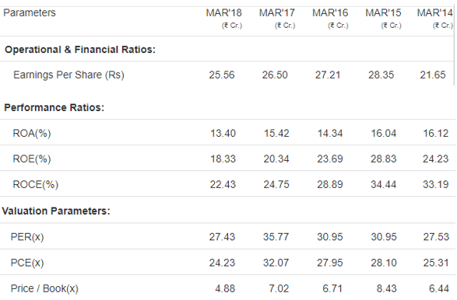
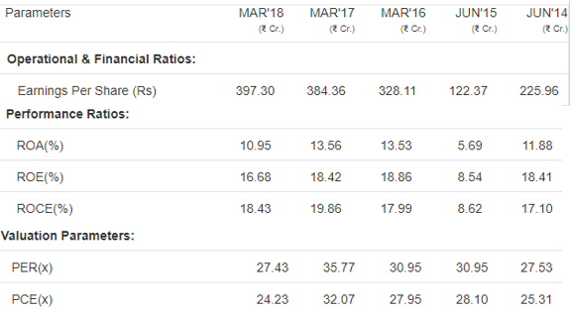
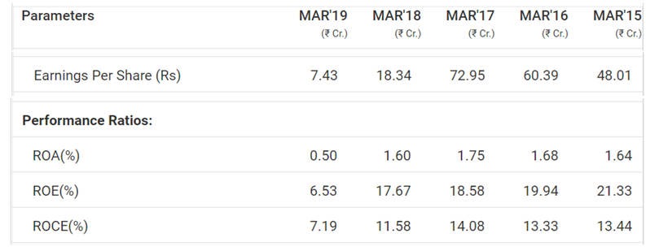
Yes Bank (BFS)
DCM Shriram (Consumer)
Cummins India Ltd. (Manufacturing)
Shree Cements (Commodities)
Source: https://www.ndtv.com/business/stock

Slide 13
Thank You!

Slide 14
APPENDIX

Slide 15
BANKING & FINANCIAL SERVICES

Slide 16
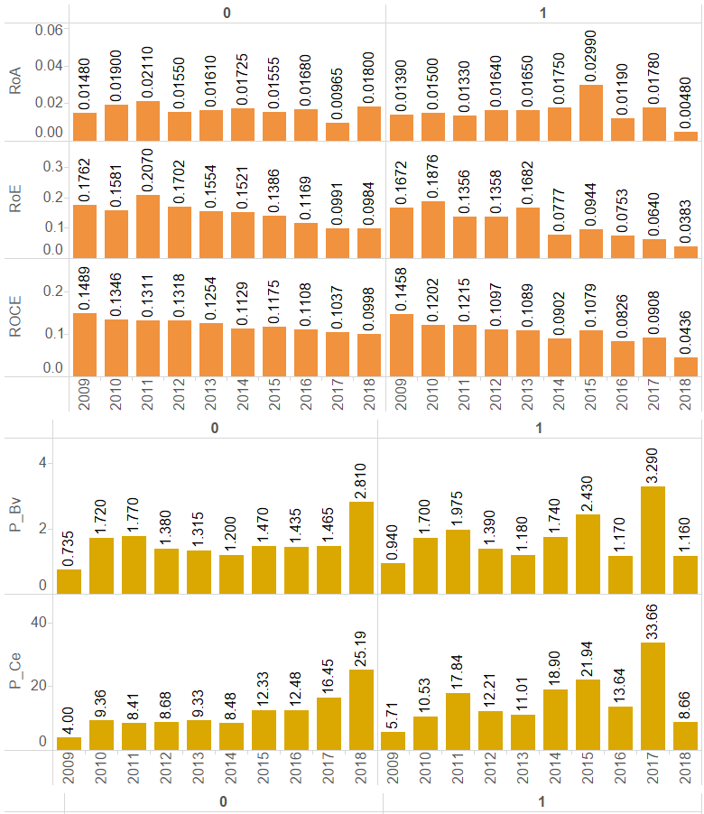
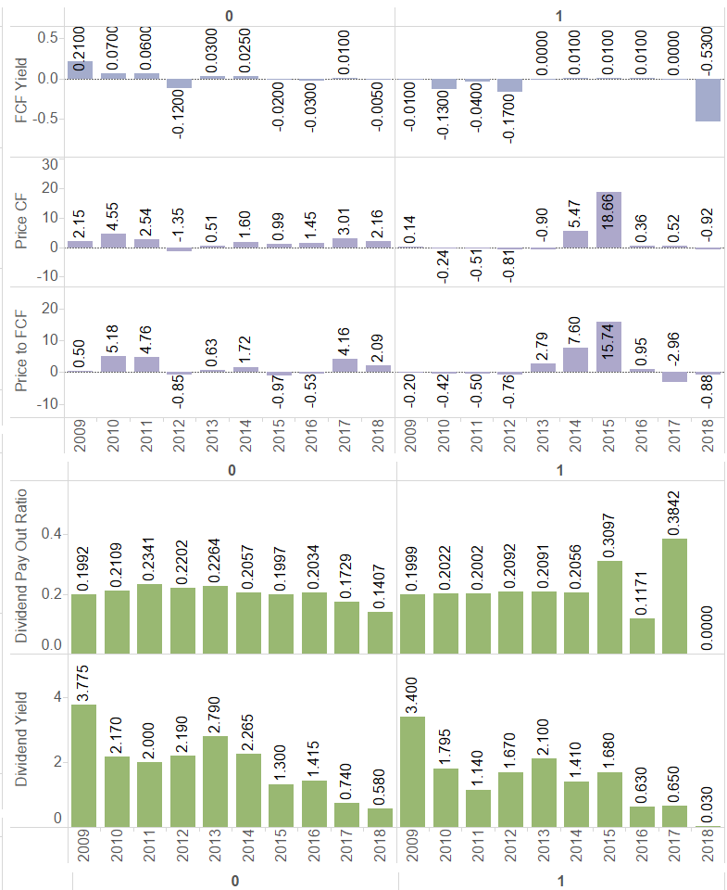

Slide 17
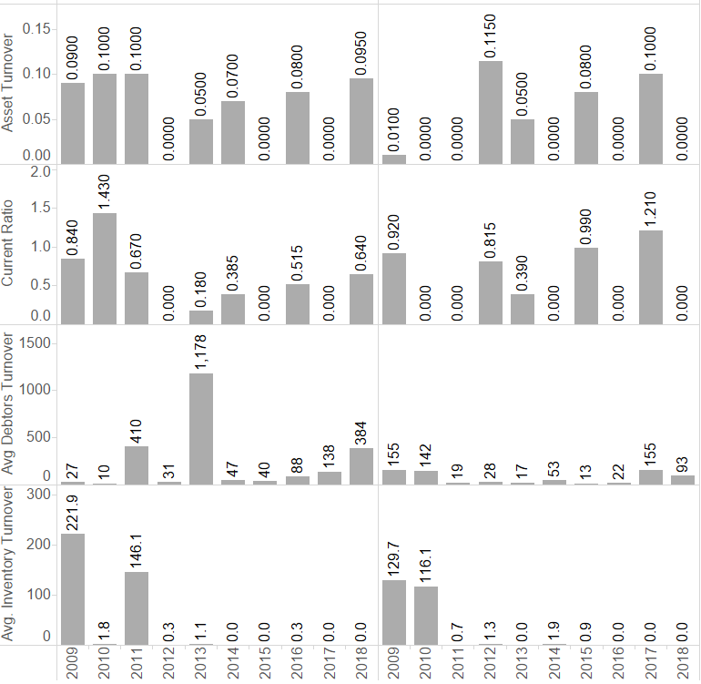
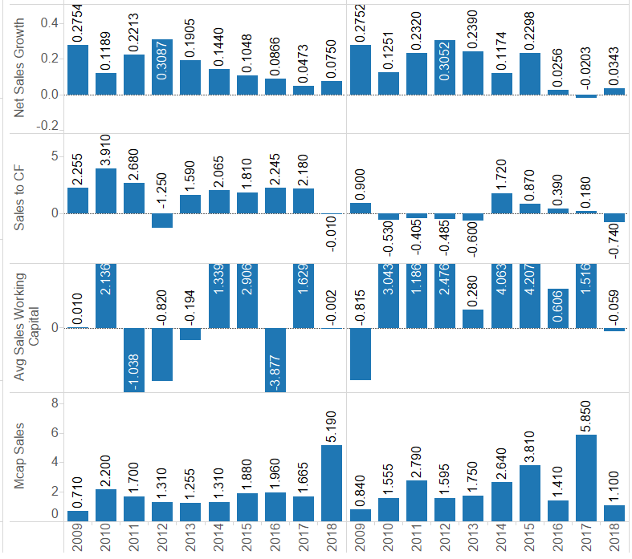

Slide 18
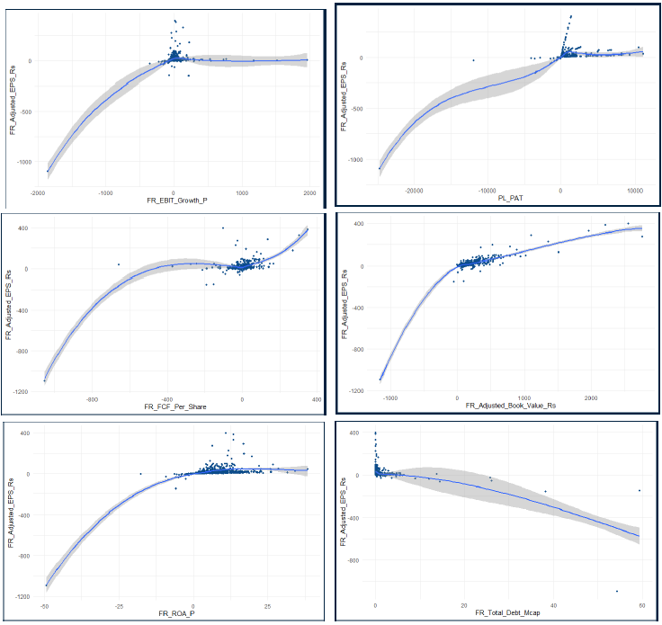
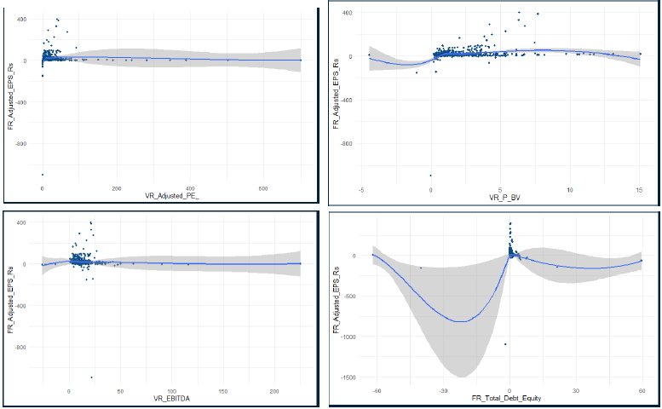
Strong Relationships
Weak Relationships
MFG

Slide 19
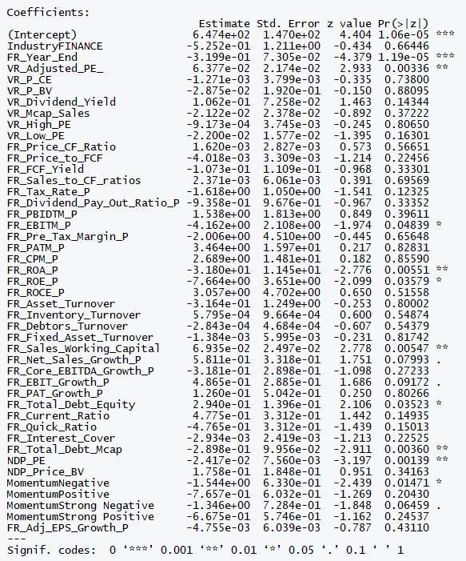
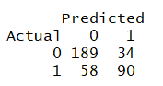
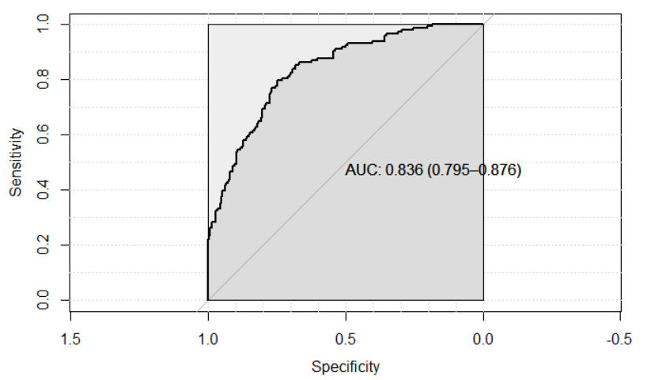
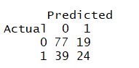
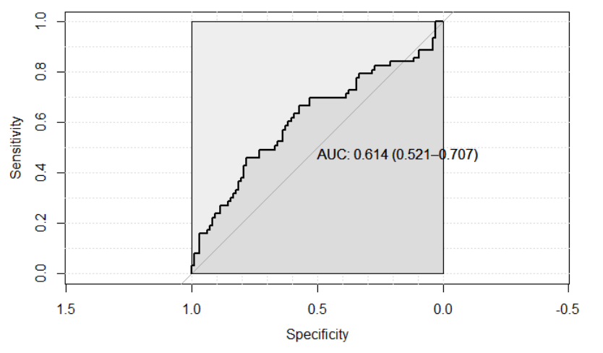
STAGE 2 – LOGISTIC REGRESSION
Train Data
Test Data

Slide 20
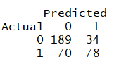
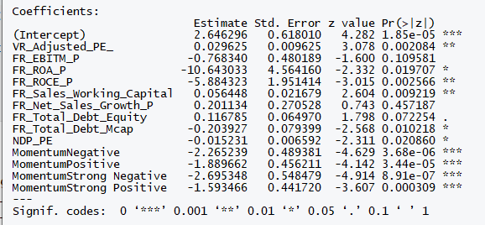
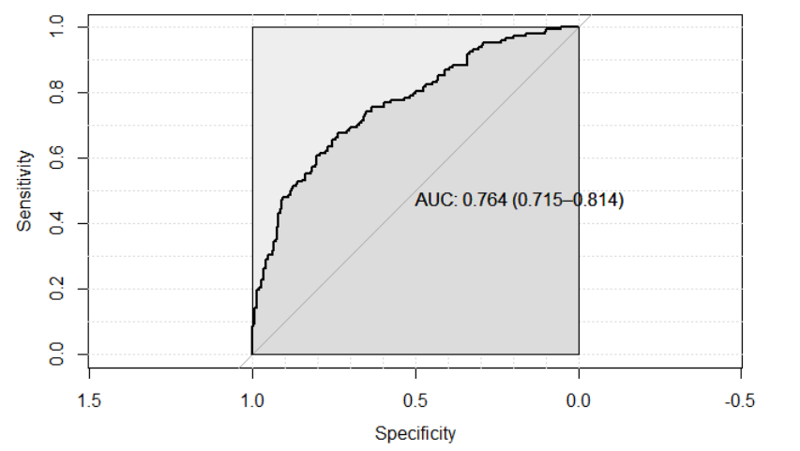
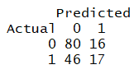
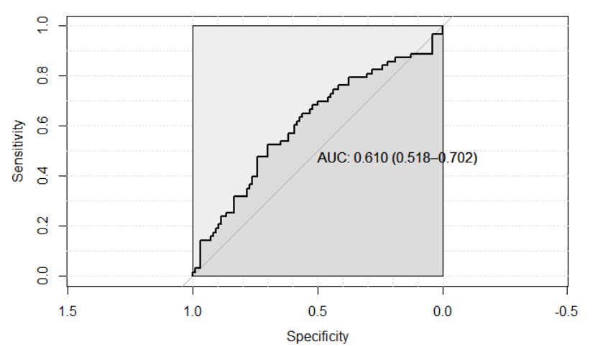
STAGE 2 – LOGISTIC REGRESSION
Train Data
Test Data

Slide 21
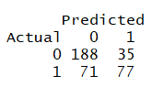
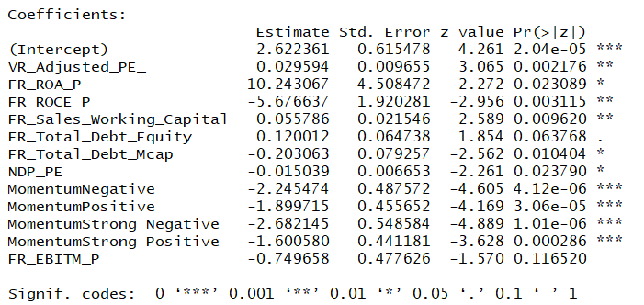
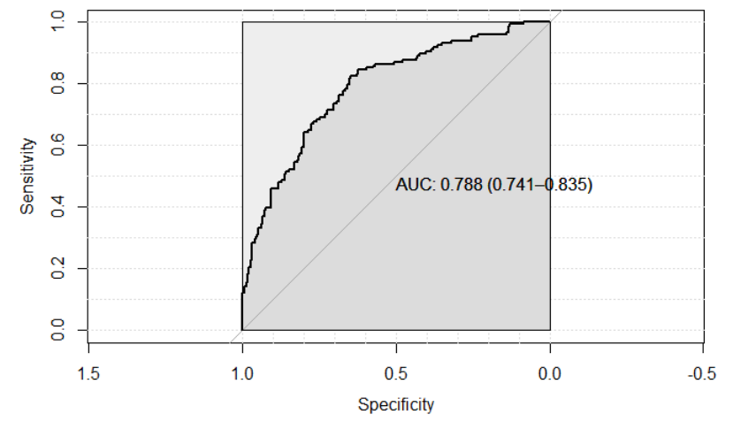
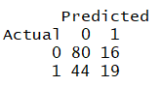
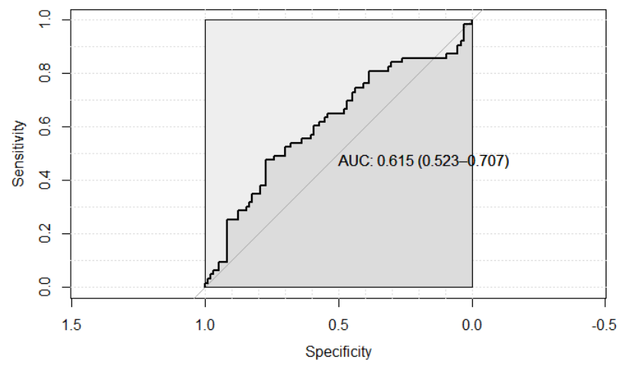
STAGE 2 – LOGISTIC REGRESSION
Train Data
Test Data

Slide 22
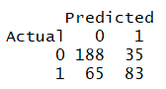
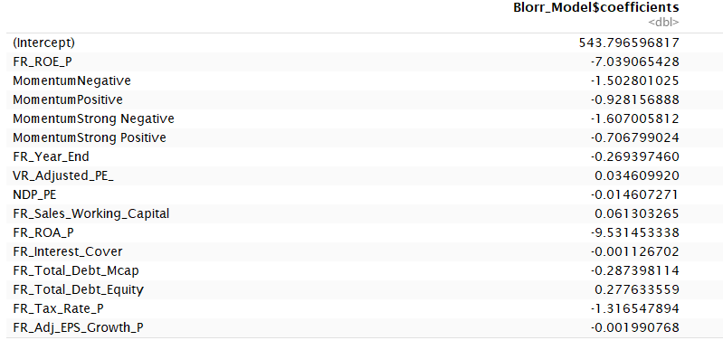
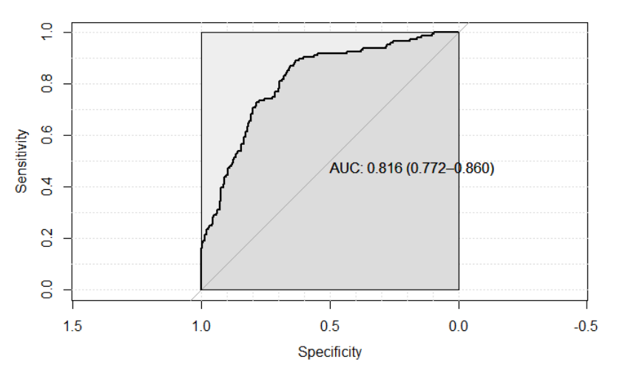
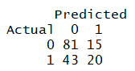
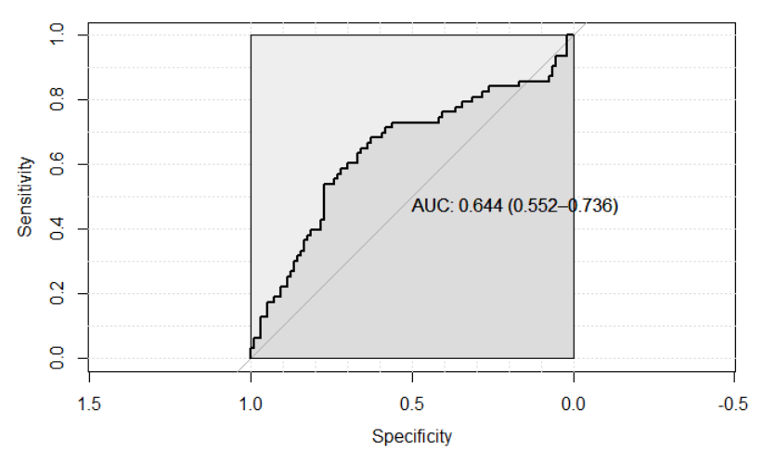
STAGE 2 – LOGISTIC REGRESSION
Train Data
Test Data

Slide 23
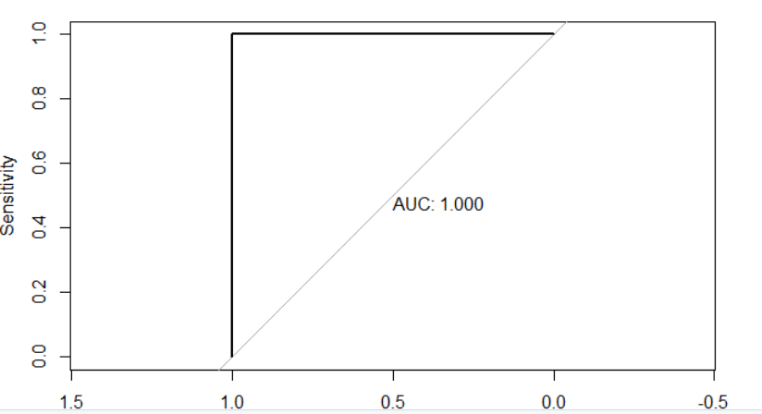
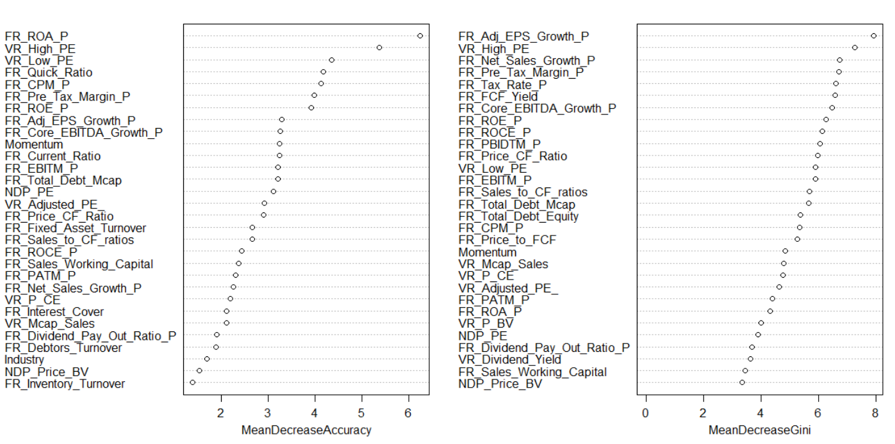
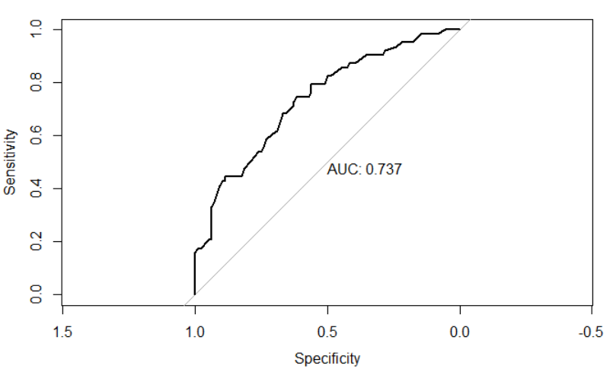
STAGE 2 – RANDOM FOREST
Train Data
Test Data

Slide 24
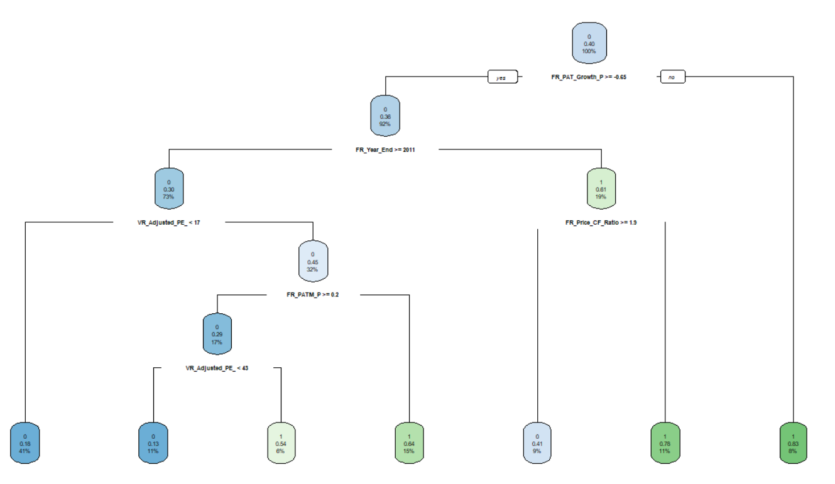
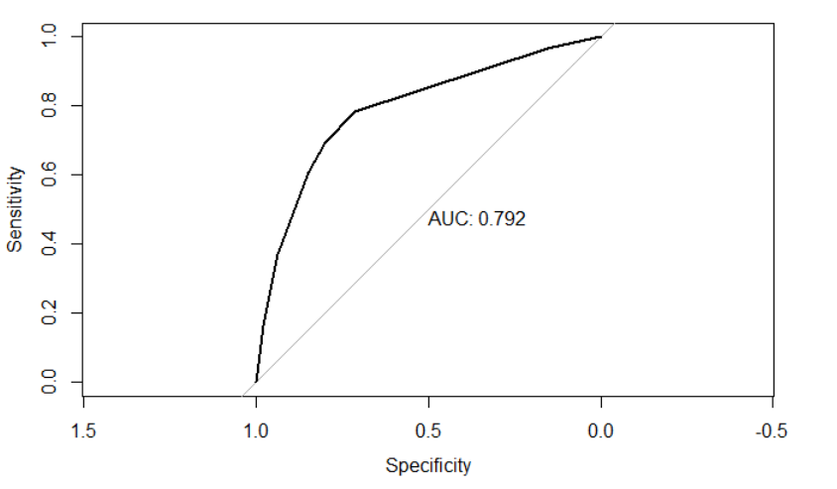
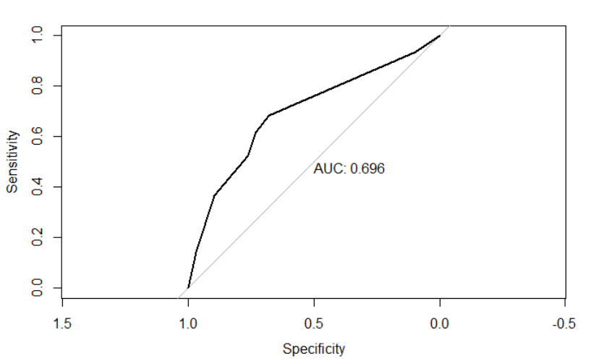
STAGE 2 – DECISION TREE
Train Data
Test Data

Slide 25
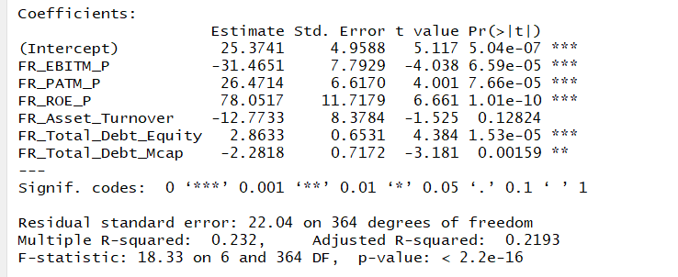
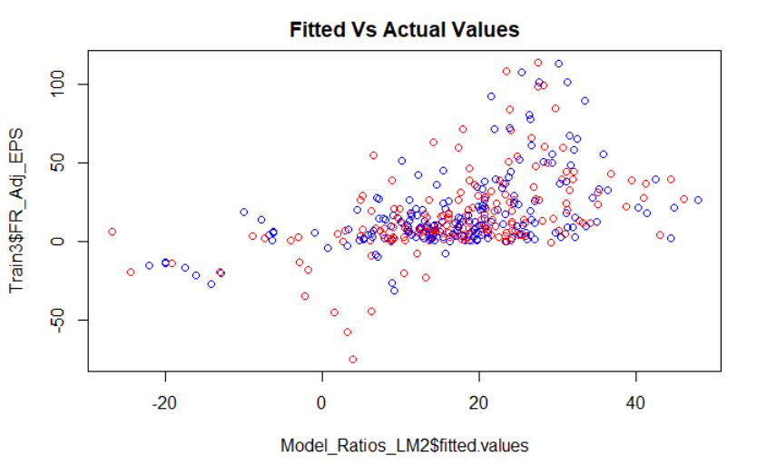
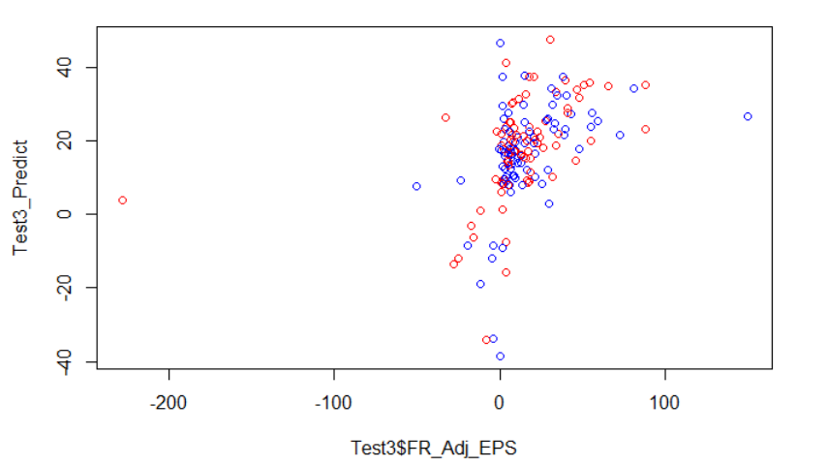
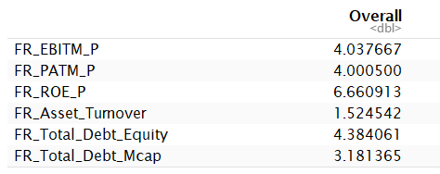
STAGE 2 – LINEAR REGRESSION
TRAIN DATA
TEST DATA
VARIABLE IMPORTANCE

Slide 26
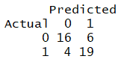
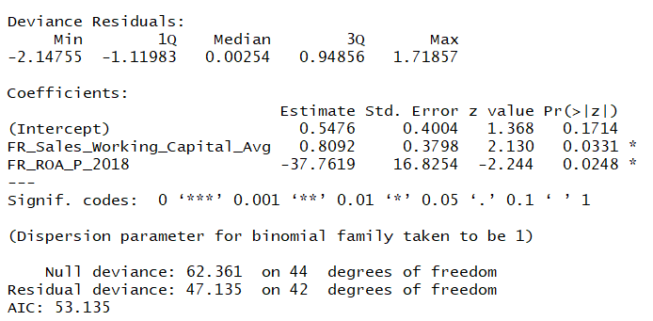
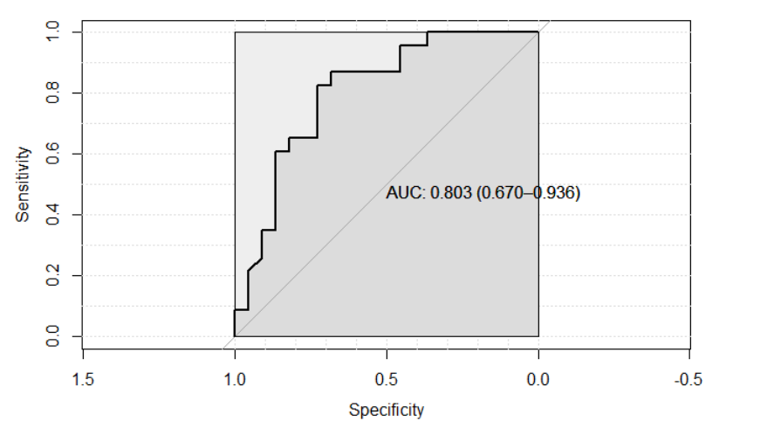
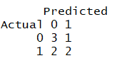


STAGE 3 – LOGISTIC REGRESSION
Train Data
Test Data
Variable Importance

Slide 27
MANUFACTURING

Slide 28




Slide 29




COMM
Notes:
There is a level shift in the Adj EPS in the Year 2016
This surge is led by the Auto Ancillaries Industry
This was primarily led by the MRF in 2016

Slide 30

Notes:
Logistic Regression output on Stage2 data without multicollinear variables

Slide 31

Notes:
Linear Regression output on Stage2 data without multicollinear variables

Slide 32

Notes:
Logistic Regression output on Stage3 data without multicollinear variables

Slide 33
COMMODITIES

Slide 34





COMMODITIES

Slide 35





Slide 36


Slide 37


Slide 38


Slide 39
CONSUMER

Slide 40







Consumer – Logistic Regression Full Model

Slide 41






Consumer – Logistic Regression Model II

Slide 42







Consumer – Logistic Regression StepWise - Blorr

Slide 43





Consumer – Random Forest

Slide 44

Stage I – Significant Variables

